Slide 1
Team106online
Sprint 1

Slide 2
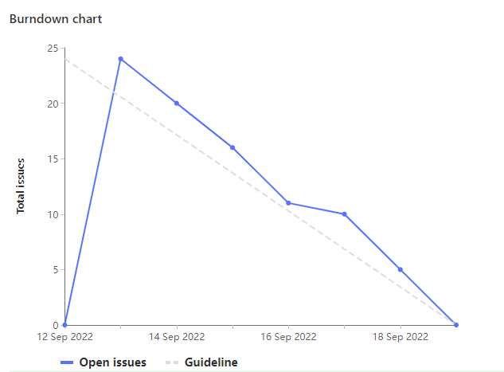
Sprint Progress

Slide 3
What Went Well
What To be Done Differently
Pair programming sessions throughout the whole team
Good at being dynamic with meeting times and communicating throughout the week
Git workflow needs to be improved
Merging work sooner
Branching for issues
Branching strategies
Pipeline (CI/CD)?
Make sure to break down issues as opposed to being high level summaries
Assigning tasks should be done fully sooner for the remaining sprints

Slide 4
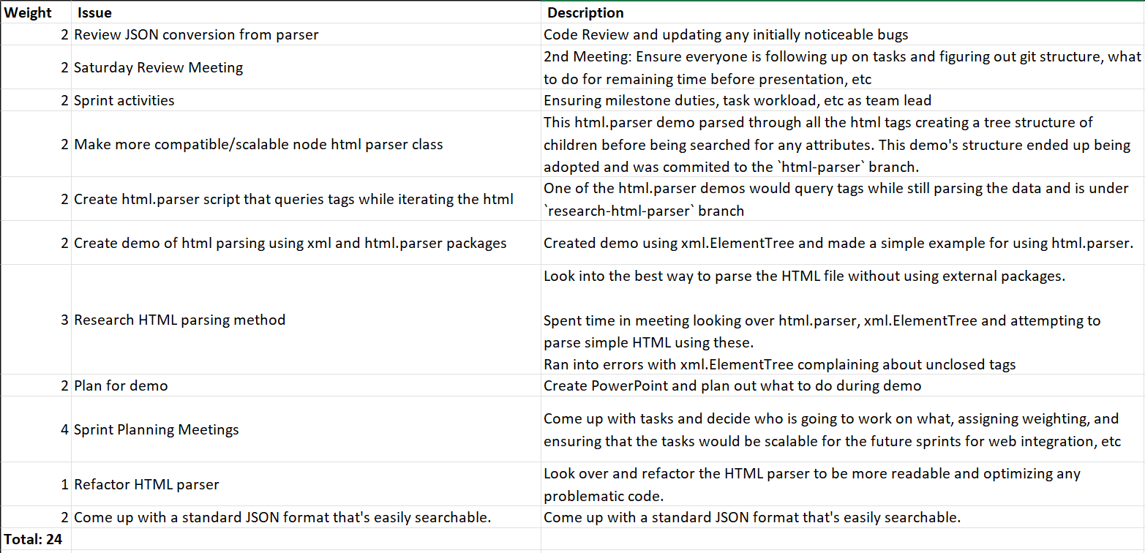
Team Member: Hyrum Nantais
Work Highlights
Researching HTML parsers in Python
Contributing to final HTML course parser
Make script to track gitlab weightings per person and create csv of your tasks

Slide 5
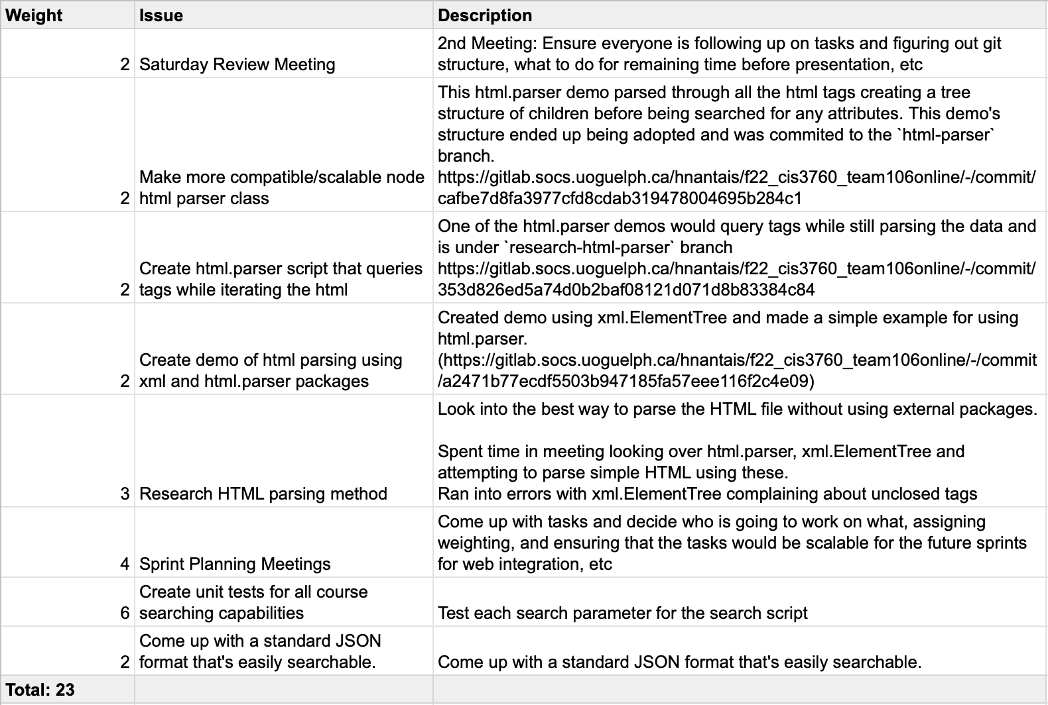
Team Member: Samuel Guilbeault
Work Highlights
Researching HTML parser options in Python
Contributing to the design and implementation of the node-based HTML parser
Unit tests for functions that power the search script

Slide 6
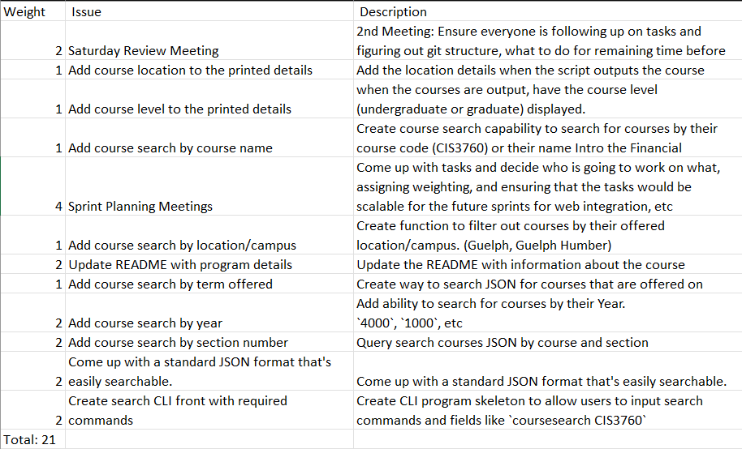
Team Member: Rehan Nagoor
Work Highlight:
Contributed to adding core search query functionalities.
Contributed to updating and adding more details to the search script output
Contributed to creating the Readme

Slide 7
Team Member: Muhammad Salmaan
Work Highlights
Coursework : I had a weight of 23, meaning I spent 11.5 hours in total this week.
Throughout the week, I participated in the sprint planning meetings and review meeting. I helped with research for the HTML parsing and the arg parser for when working on searching for courses on the command line.
I participated in pair programming with both Alif and Rehan (different times) for developing code for searching courses through command line arguments. This consisted of searching for courses with different characteristics.
Overall, my first sprint experience was good and I strive to learn more with each sprint.

Slide 8
Team Member: Parker Carnegie
Work Highlights
Coursework : I had a weight of 26 (13 hours)
Sprint planning & review meetings
Helped with researching Python unit testing
Participated in pair programming with Caleb and Sam to implement unit tests
Created README with Rehan

Slide 9
Team Member: Ivan Odiel Magtangob
Work Highlights
Coursework : I had a weight of 20 (10 hours)
Sprint planning & review meetings
Helped with researching Python unit testing
Researched Python JSON validation
Researched VBA for office

Slide 10
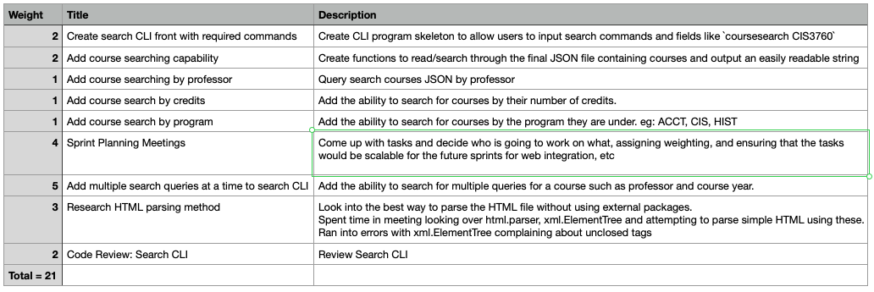
Team Member: Alif Merchant
Work Highlights
Coursework : weight of 21 (10 hours)
Worked mainly on parsing JSON file and writing the search logic.
Refactored CLI tool to work with multiple queries.

Slide 11
Team Member: Caleb Beere
Work Highlights: Coursework weighted at 14 hrs (28/28)
Refactored initial parser to format and write a json file containing course info
Sprint planning & review meetings
Helped with researching python unit testing
Participated in pair programming session with Parker to implement unit tests

Slide 12

Demo time!

